Slide 1
Vida Abdolzadeh Tutor: Prof.Nicola Petra XXXII Cycle - I year presentation
Neural network

Slide 2
Background
MSc
Computer Engineering – Tabriz University,Iran – Augustus 21th 2014
Subject:Computer Architecture
Title: Reversible 4-Bit Parallel Excess-3 Adder For Nanotechnology Based Systems
PhD
Electronic Group
Prof.Nicola Petra
Athenaeum fellowship
Electronic laboratory

Slide 3
Why neural network
features
Features
computation
Layer 1
Layer 2
Layer n
classification
Neural networks are widely used today for image and speech recognition: interaction between humans and electronics devices
Usually implemented with high-end computers
Many applications do not allow the use of high-end PC or the cloud (car devices, smart TV, domotics, IoT, etc.)

Slide 4
The solution: SoC (System on Chip)
Cheap circuits
Mid-power architectures that integrates processors and dedicated circuitry on the same chip
Adapting neural network to SoCs is not trivial:
Quantization effects need to be studied
Efficient hardware architecture must be derived

Slide 5
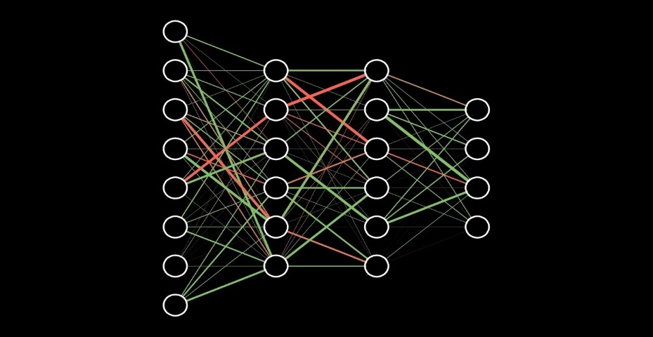
Methodology
Model the effects of circuit approximations on the network reliability (quantization)
Derive SoC architectures neural-network ready
Derive dedicated neural network co-processors
Layer accelerator: Long Short Term Memory Layer

Slide 6
Validation
Numerical analysis: Matlab / C++
Design: High level synthesis and RTL design
Prototyping
Programmable SoC: Xilinx Zynq

Slide 7
First year credits
Student: Name Surname |  |  |  |  |  | Tutor: Name Surname |  |  |  |  |  |  |  |  | Cycle XXXII
vida.abdolzadeh@unina.it |  |  |  |  |  |  | nicpetra@unina.it
 | Credits year 1 |  |  |  |  |  |  |  | Credits year 2 |  |  |  |  |  |  |  | Credits year 3
 |  | 1 | 2 | 3 | 4 | 5 | 6 |  |  | 1 | 2 | 3 | 4 | 5 | 6 |  |  | 1 | 2 | 3 | 4 | 5 | 6
 | Estimated | bimonth | bimonth | bimonth | bimonth | bimonth | bimonth | Summary | Estimated | bimonth | bimonth | bimonth | bimonth | bimonth | bimonth | Summary | Estimated | bimonth | bimonth | bimonth | bimonth | bimonth | bimonth | Summary | Total | Check
Modules | 20 | 0 | 0 | 0 | 0 | 3 | 9 | 12 | 10 |  |  |  |  |  |  | 0 | 0 |  |  |  |  |  |  | 0 | 15 | 30-70
Seminars | 5 | 0 | 1.2 | 0 | 0 | 0.8 | 2 | 4 | 5 |  |  |  |  |  |  | 0 | 0 |  |  |  |  |  |  | 0 | 5.7 | 10-30
Research | 35 | 10 | 8.8 | 10 | 8 | 6.2 | 1 | 44 | 45 |  |  |  |  |  |  | 0 | 60 |  |  |  |  |  |  | 0 | 39 | 80-140
 | 60 | 10 | 10 | 10 | 8 | 10 | 12 | 60 | 60 | 0 | 0 | 0 | 0 | 0 | 0 | 0 | 60 | 0 | 0 | 0 | 0 | 0 | 0 | 0 | 60 | 180

Slide 8
Thank you for your pay attention

